Slide 1


HOTEL AGGREGATOR ANALYSIS BY USING POWER BI
INTERNSHIP PROJECT
BATCH : MIP-DA-07
MASANAM SURAJ

Slide 2
Table of contents
01
Problem statement
02
Project objective
03
Key insights
04
recommendation

Slide 3
Project statement
This project aims to analyze a dataset of hotel aggregrator listing using power BI . The dataset comprises various attributes related to listings , hotels, reviews and availability .the objective is to create comprehensive visualization and insights that shed light on trends , pattern , and factors influencing the performance of listing
the hotel aggregrator dataset contained data of cover 10000 hotels situated in various countries including Australia, new York etc……
Various insights were derived including availability status , verification methods, hotel listings, accommodation capacity , review scores..etc

Slide 4
Project objectives
1. Geographical insights :
visualize the distribution of listing on a map to identify popular neighborhoods
Pricing and availability analysis :
analyze pricing trends based on property types , room types and accommodation
capacity
Host performance :
evaluate host characteristics ; including super host status,response times and
verification methods
Review scores and guest satisfaction:
examine review scores and their impact on overall listing performance
Property types and room analysis :
analyze the distribution of property types and room types

Slide 5
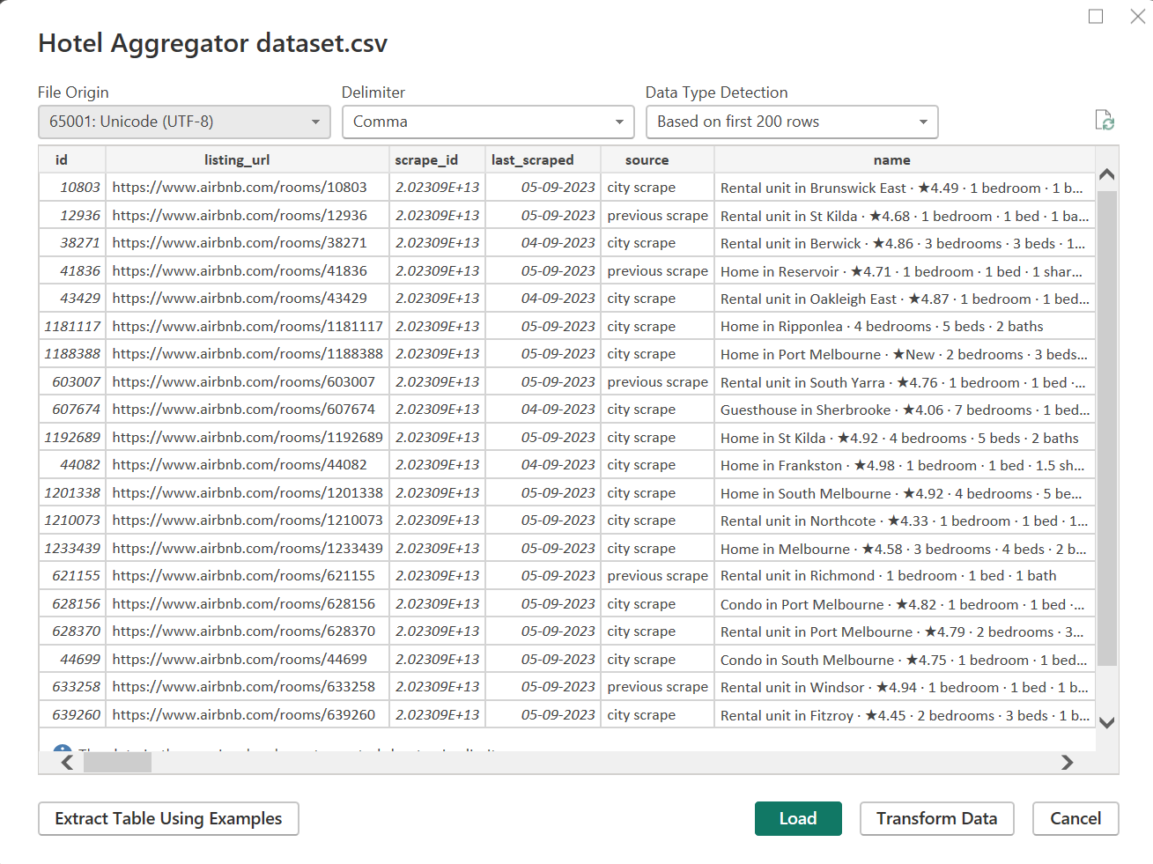
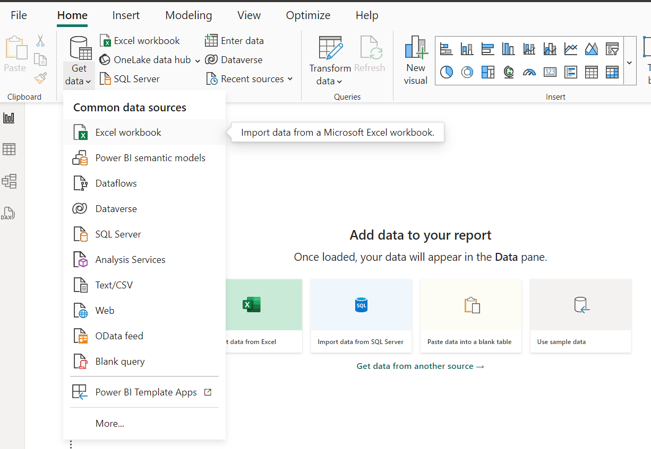
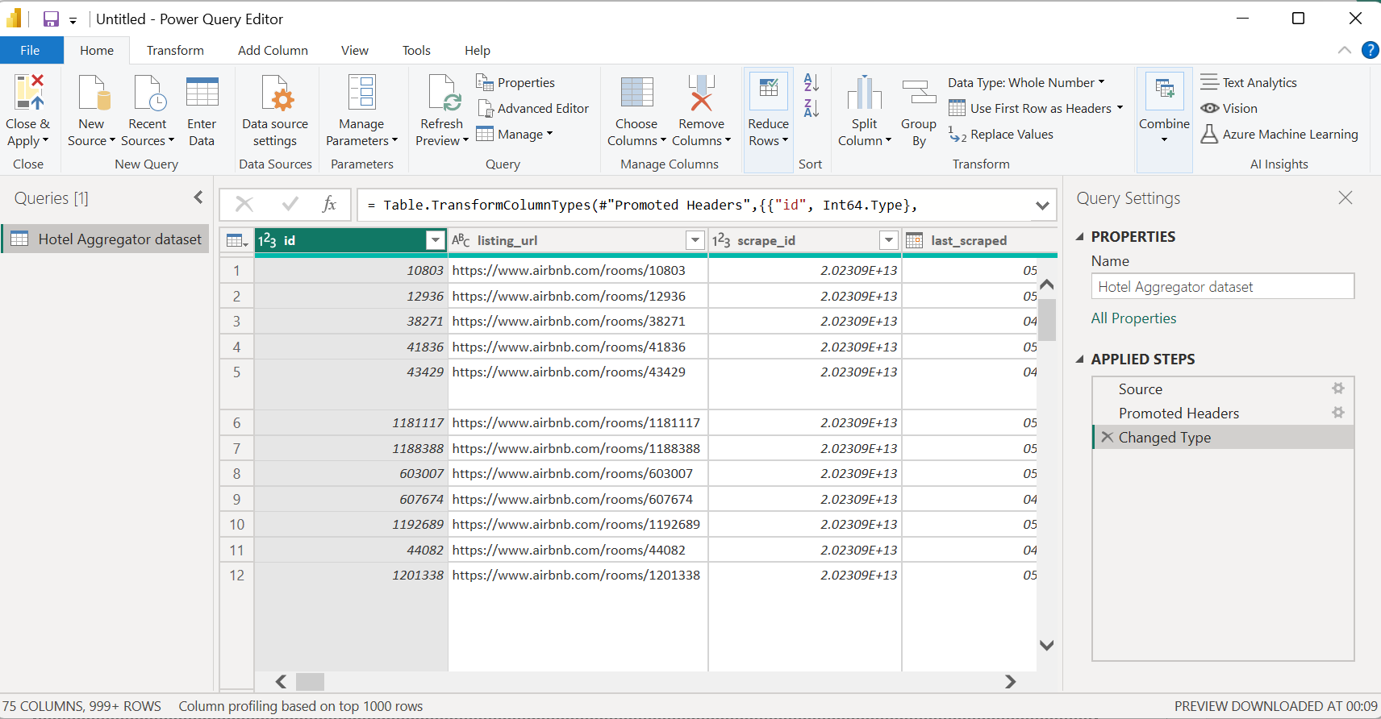
Importing data into power BI

Slide 6
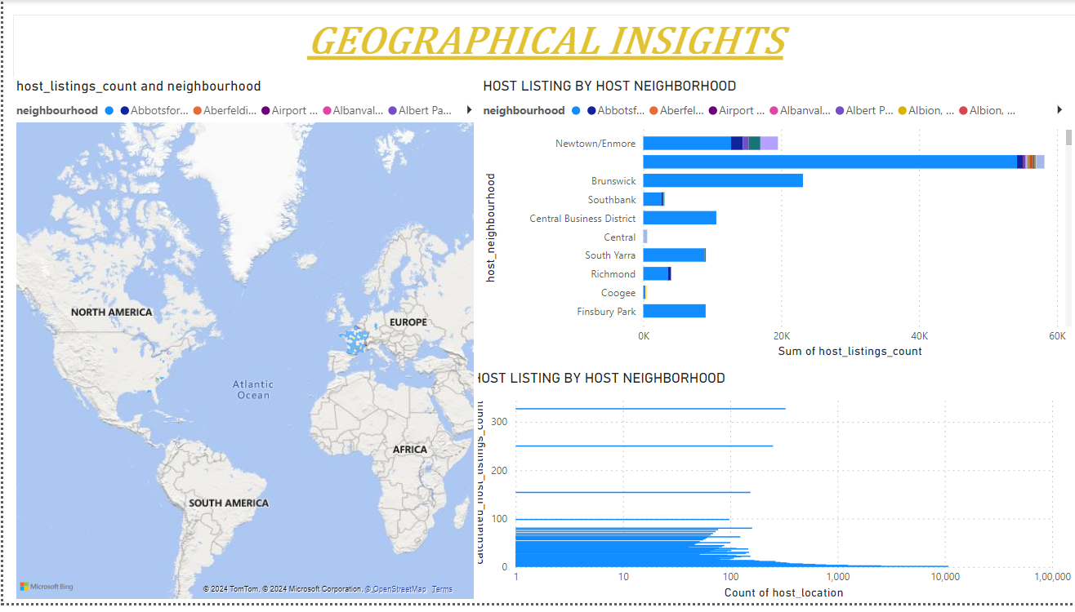

Slide 7
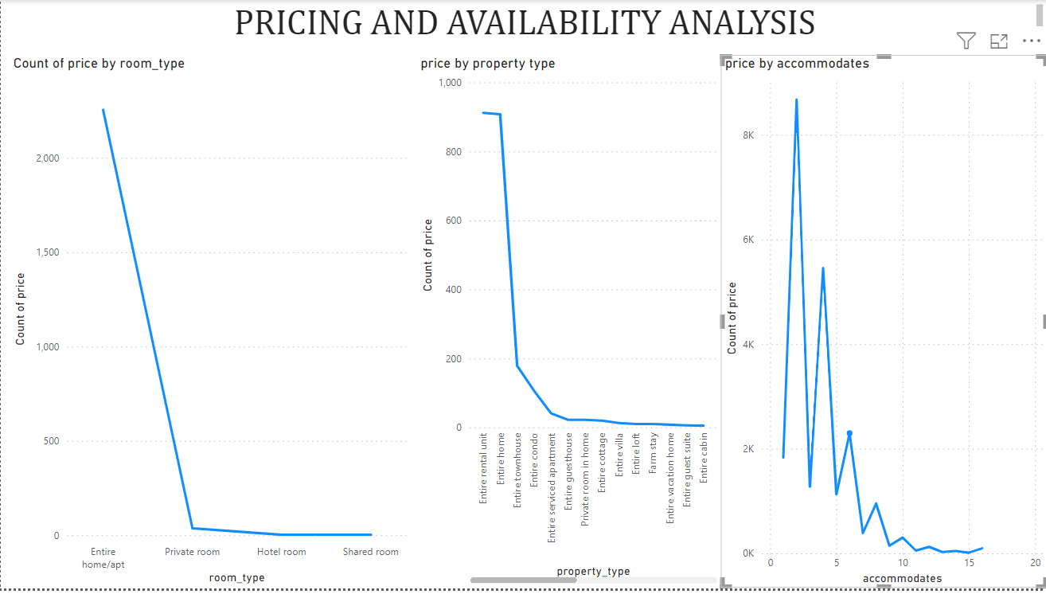

Slide 8
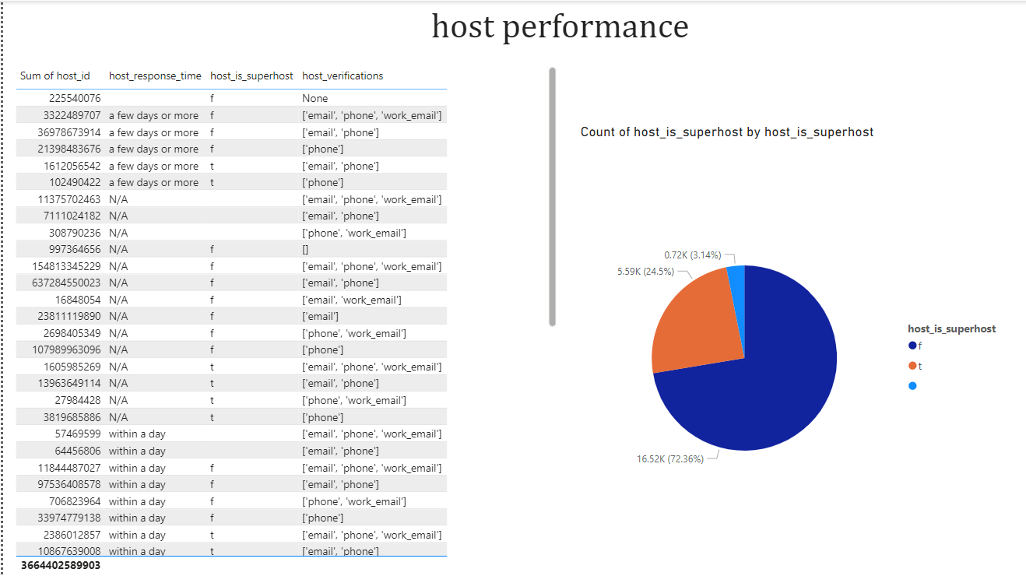

Slide 9
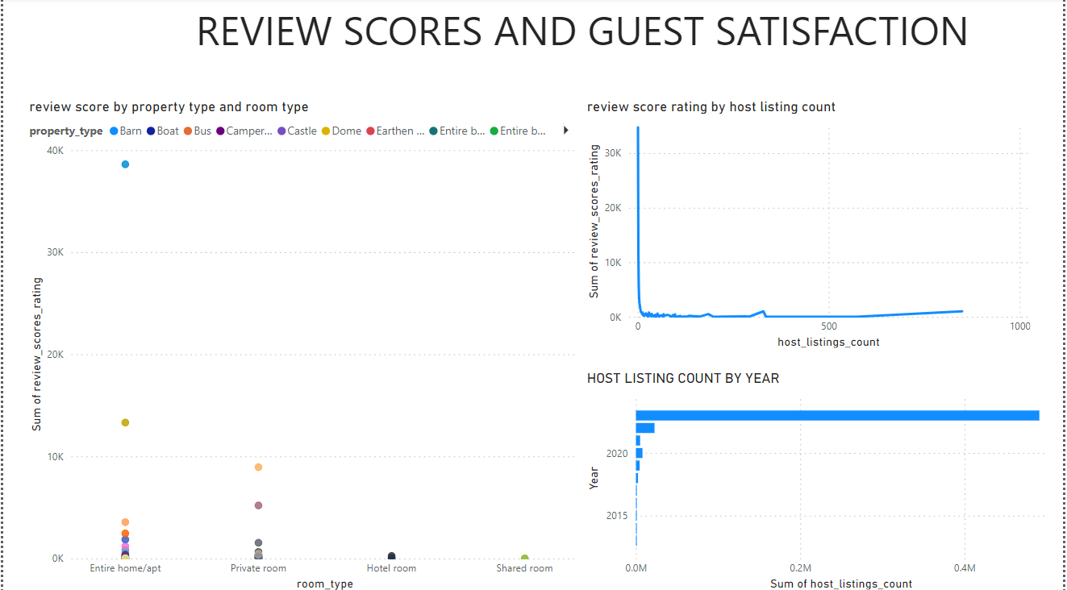

Slide 10
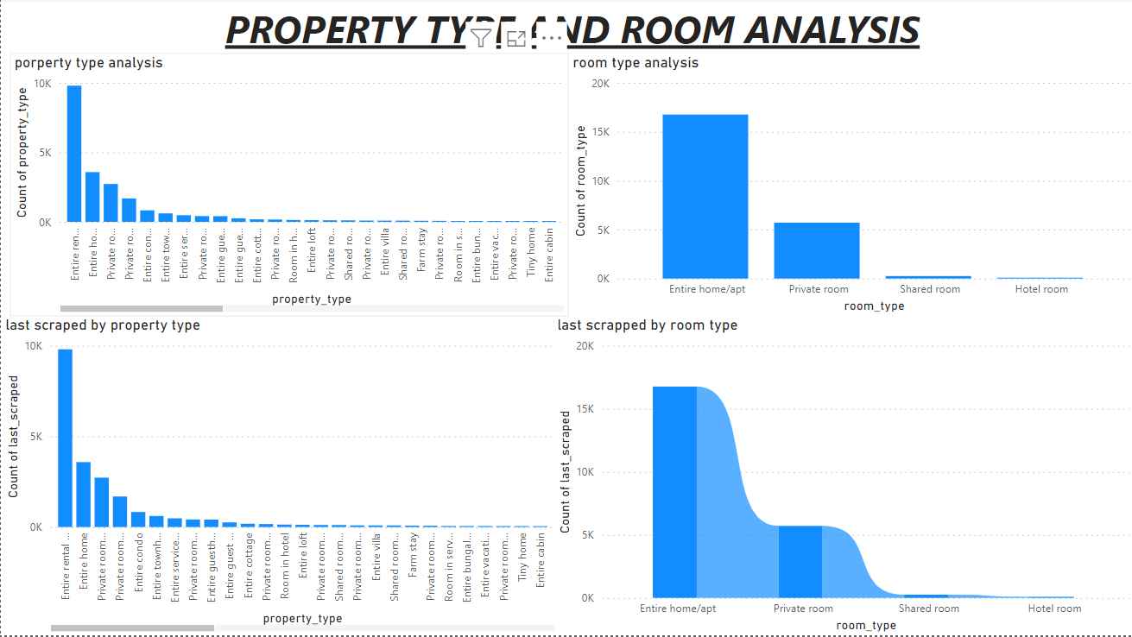

Slide 11
Key insights
Geographical insights : to provide insights into distribution of listing in popular neighborhoods , host location and host neighborhood.
Pricing & availability analysis : it showcases average prices for different property types , room types and based on accommodation
Host performance : present insights into host performance metrices such as host response time , host verification methods, and host status. By analyzing this data, once can understand the distribution of host response times, verification methods used by hosts, and the proportion of super hosts versus regular hosts.
Review scores & guest satisfaction : it displays relationship between scores and host listing counts, host total listing count by year , and review based on property and room types
Property types and room analysis : it represents the count of different property types and room types, showcasting the distribution of accommodation options/

Slide 12
Recommendations
Host performance optimization
Make hosts to maintain quick response time to enhance guest satisfaction
Consider the benefits of achieving super host status for improved credibility
Pricing and availability strategies :
Analyze pricing trends for different property and room types to set competitive rates
Adjust pricing based on accommodates to maximize revenue and occupancy

Slide 13
Guest satisfaction enhancement :
focus on improving review scores by providing expectional services and amenities
Track guest satisfaction levels over time to identify areas for improvement
property and room type management
Understand the popularity of different property and room types tooptimize inventory
Utilize insights to enhance marketing strategies and target drelevent customer segments

